Slide 1
Managing Asynchronous APIs
Ian Cooper
@ICooper
@ICooper@hachyderm.io
@icooper.bsky.social

Slide 2
Who are you?
Software Developer for more than 25 years
Stuff I care about: Messaging, EDA, Microservices, TDD, XP, OO, RDD & DDD, Code that Fits in My Head, C#
Places I have worked: DTI, Reuters, Sungard, Beazley, Huddle, Just Eat Takeaway
No smart folks
Just the folks in this room

Slide 3
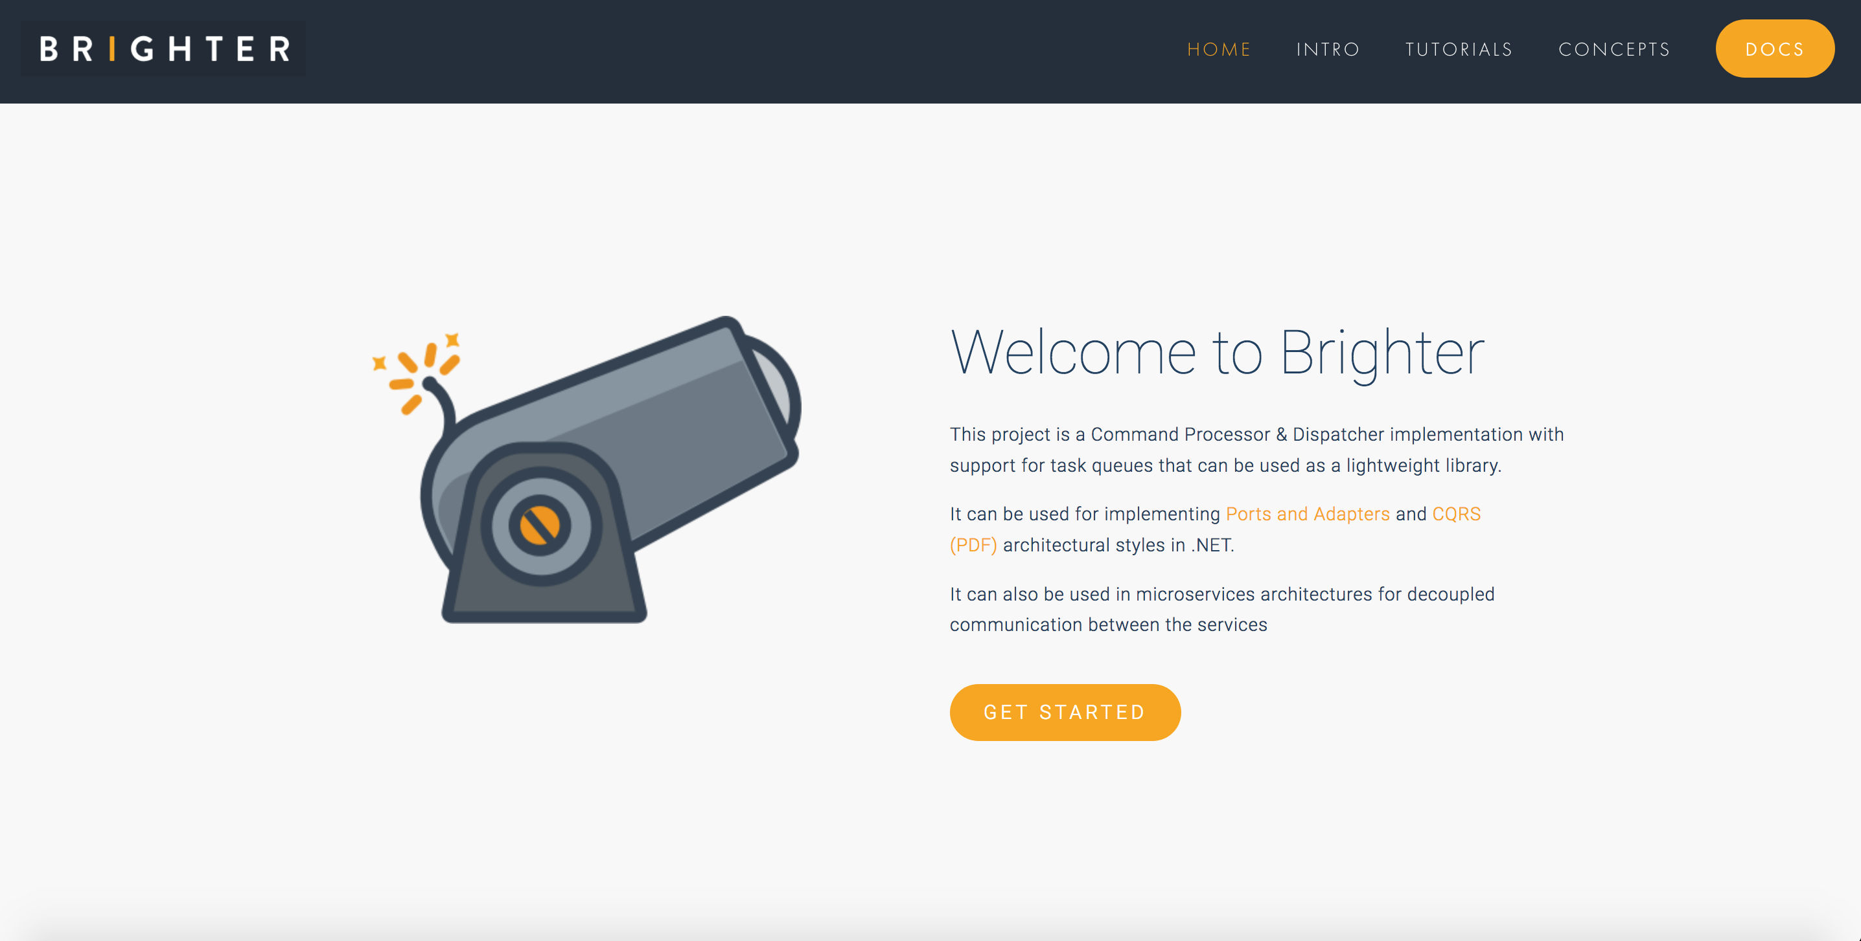

Slide 4
Agenda
Endpoints
Discovery
Describing
Contracts
Tools

Slide 5
Endpoints
5

Slide 6
Synchronous Conversation
Endpoints
Discovery
Describing
Contracts
Tools
In a synchronous conversation, both parties must be present for communication to succeed.
Example: a phone call
Request
Reply
Many options for how describe these: OpenAPI, GraphQL, gRPC, Thrift, SOAP etc

Slide 7

Asynchronous Conversation
Endpoints
Discovery
Describing
Contracts
Tools
In an asynchronous conversation, the receiver does not need to be present at the time the sender communicates with them, using store and forward to pick up the message later.
Example: snail mail
Request
Response
How do we describe these?

Slide 8
The ABC of Endpoints
Endpoints
Discovery
Describing
Contracts
Tools
Endpoints are places where messages are sent or received (or both), and they define all the information required for the message exchange.
An endpoint describes in a standard-based way where messages should be sent, how they should be sent, and what the messages should look like.
https://docs.microsoft.com/en-us/dotnet/framework/wcf/fundamental-concepts

Slide 9
Bounded Context
Endpoints
Discovery
Describing
Contracts
Tools
A bounded context is a model of our domain - there can be many models of the same domain (local viewpoints) - or of the subdomains of the domain - and thus there can be many bounded contexts
A bounded context finds expression as code, schemas, etc. used by a team (or teams). A microservice is implicitly a bounded context
Restaurant
Restaurant
Restaurant Availability
Restaurant Management
We name a bounded context.
Within a bounded context we may have differing representations of a domain concept - for example a restaurant - because we do not need the same information to perform our function, or due to history.

Slide 10
Customer Supplier
Endpoints
Discovery
Describing
Contracts
Tools
Because of the dependency we often use the phrase: supplier for the upstream team and customer for the downstream team. The supplier needs to meet the needs of the customer.
A downstream team depends upon an upstream team. If the upstream team makes changes to its model the downstream team must react.
Customer
Supplier
Upstream
Restaurant
Restaurant
Restaurant Availability
Downstream
Restaurant Management

Slide 11
Model Integration Approach - Conformance
Endpoints
Discovery
Describing
Contracts
Tools
In conformance, the customer uses the internal model of the upstream - this creates coupling between the two which removes independent deployability. It is antithetical to microservices.
Upstream
Restaurant
Restaurant
Restaurant Availability
Downstream
Restaurant Management

Slide 12
Model Integration Approach - Anti-Corruption Layer
Endpoints
Discovery
Describing
Contracts
Tools
An anti-corruption layer provides an ad-hoc translation service per customer that translates the format used by the supplier to that understood by the customer.
Upstream
Restaurant
Anti-Corruption Layer
Restaurant
Restaurant Availability
Downstream
Restaurant Management

Slide 13
Model Integration Approach - Open Host Service
Endpoints
Discovery
Describing
Contracts
Tools
An open-host service reduces the duplication of many anti-corruption layers by supporting shared models. The upstream team agrees to support an external model that may differ from their internal one. It implies an open host model that supplier agrees to support and customer agrees to depend upon.
Upstream
Open Host Service
Restaurant
Restaurant
Restaurant Availability
Downstream
Restaurant Management

Slide 14
Open Host Service – Necessary Coupling
Endpoints
Discovery
Describing
Contracts
Tools
An open-host service creates coupling between the supplier and customer. This is necessary coupling because to collaborate with others we must allow others to take a dependency on us.
The contract makes necessary coupling habitable for both supplier and customer.
Dependency
Open Host Service
Restaurant
Restaurant
Restaurant Availability
Restaurant Management
In promise theory the service is an agent that makes a promise about its capabilities.
An open-host service provides a contract – provided we honor that contract, we can change our service implementation details.
We document a contract so all sides know what they can rely on.

Slide 15
Discovery
15

Slide 16


Discovering Producers
Endpoints
Discovery
Describing
Contracts
Tools
- Do I want to search all the GitHub Repos in case you documented it?
- Do I want to put a message out on Slack or Teams asking if anyone knows who exposes it?
?
Restaurant Availability
How do I know who exposes the data that I need? How do I find the endpoint that I want to consume from?

Slide 17
Discovering Producers
Endpoints
Discovery
Describing
Contracts
Tools
- Do I search all the GitHub Repos looking for the name of my message hoping to find it?
- Do I want to put a message out on Slack or Teams asking if anyone consumes it?
?
Endpoint
RestaurantHoursChanged
Restaurant Management
Who consumes the messages I send? Whom do I have a contract with?

Slide 18
Asynchronous Endpoints
Endpoints
Discovery
Describing
Contracts
Tools
Our Asynchronous APIs need documenting just like any other API (HTTP etc).
We need to document the message, because it is the contract
Endpoint
Restaurant Availability
Downstream
Restaurant Management
We need to document who sends and receives to understand flow
We need to document the channel so we know where the message is flowing
We need to document the protocol so we know how to send-receive

Slide 19
The ABC of Endpoints
Endpoints
Discovery
Describing
Contracts
Tools
Endpoints are places where messages are sent or received (or both), and they define all the information required for the message exchange.
An endpoint describes in a standard-based way where messages should be sent, how they should be sent, and what the messages should look like.
https://docs.microsoft.com/en-us/dotnet/framework/wcf/fundamental-concepts

Slide 20
Endpoint – Documenting the Contract
Endpoints
Discovery
Describing
Contracts
Tools
Endpoint
We will need to agree what the metadata – the headers are – and we will need to agree the encoding and schema of the body.
An message is data that we send or receive
Message
Upstream
Metadata (Headers)
RestaurantHoursChanged
Endpoint
Data (Payload)
Downstream
Restaurant Management
Channel
A channel is the logical pipe over which messages flow. It is our address.
Binding
A binding is the details of how we implement the channel: what transport and encoding does the service support that allows messages to flow for example AMQP and Plain/Text.
In principle you can have multiple bindings for a channel.

Slide 21
Describing
20

Slide 22
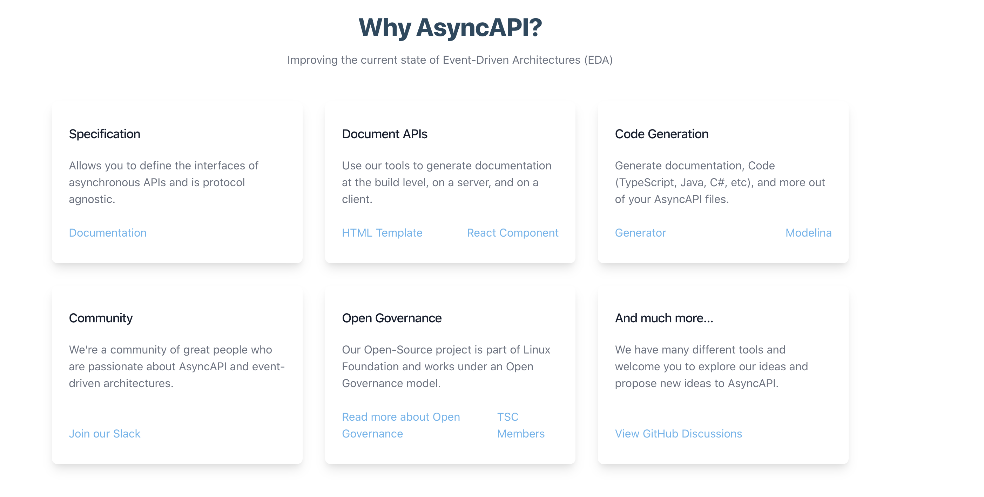
AsyncAPI
Endpoints
Discovery
Describing
Contracts
Tools

Slide 23
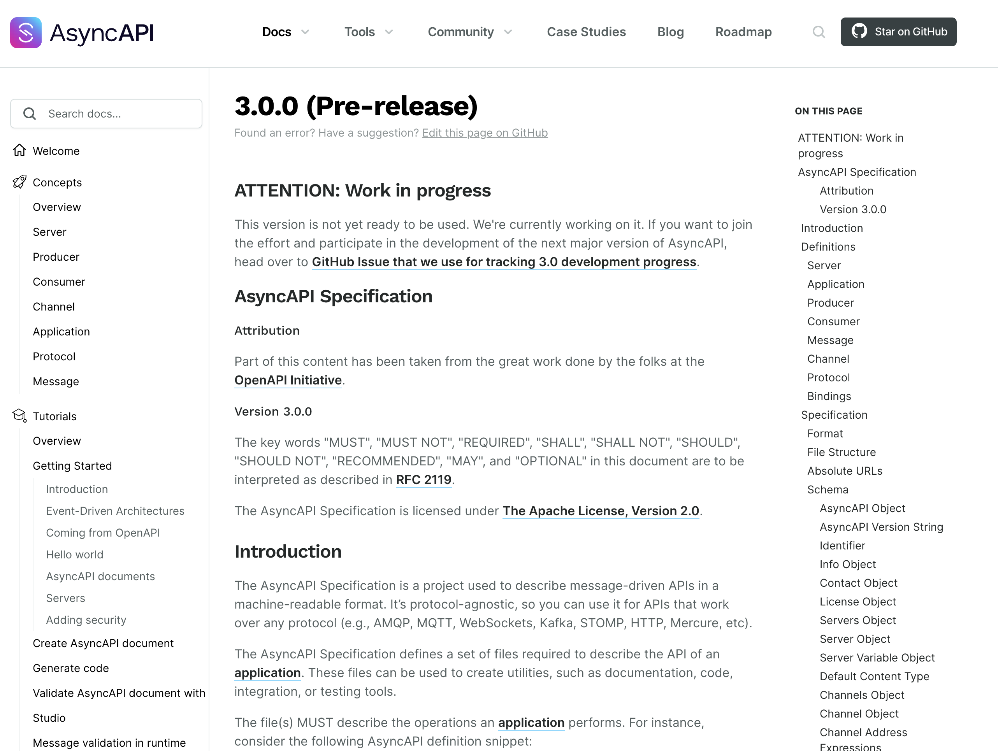
V3 is Coming
Endpoints
Discovery
Describing
Contracts
Tools

Slide 24
Client vs. Application
Endpoints
Discovery
Describing
Contracts
Tools

Slide 25
AsyncAPI Elements (V2)
Endpoints
Discovery
Describing
Contracts
Tools
Channels define a set of operations that clients can perform
publish, receive messages
subscribe, send messages
Channels
Application
An application is running code that acts as a producer (sends messages) or a consumer (receives messages)
Binding
Message
Operations
P
H
Binding
Bindings are protocol specific information
Messages are sent by operations
Server
A message must have a payload and can have headers. Headers may protocol or application specific.
Binding

Slide 26
Document Structure (V2)
The root object. Identifies the application being documented
AsyncAPI Object
Metadata for this specification
Info Object
Connection details for the server
Servers Object
The channels being used by the application
Channels Object
Channel item Object
The collection of operations on this channel
Operation Object
Defines an operation – publish or subscribe – made available by the application on this channel
Components Object
Re-usable components
Tags Object
User defined tags for this specification

Slide 27
AsyncAPI Elements (V3)
Endpoints
Discovery
Describing
Contracts
Tools
Operations send or receive messages over channels.
Binding
Application
Operations
Channels
Message
Binding
P
H
An application is running code that has operations:
producer (sends messages) - -
consumer (receives messages)
A message must have a payload and can have headers. Headers may protocol or application specific.
Server
Bindings are protocol specific information
Binding
A server has a protocol by which messages are exchanged.

Slide 28
Document Structure (V3)
Endpoints
Discovery
Describing
Contracts
Tools
AsyncAPI Object
The root object. Identifies the application being documented
Info Object
Metadata for this specification
Connection details for the server
Servers Object
The channels being used by the application
Channels Object
Operation Object
Defines an operation – publish or subscribe – made available by the application on this channel
Components Object
Re-usable components
Tags Object
User defined tags for this specification

Slide 29
AsyncAPI (V3) and Endpoint ABCs
Endpoints
Discovery
Describing
Contracts
Tools
AsyncAPI Object
Endpoint
Info Object
Message
Servers Object
Metadata (Headers)
Data (Payload)
Channels Object
Channel
Operation Object
Binding
Components Object
Tags Object

Slide 30
AsyncAPI Object
Endpoints
Discovery
Describing
Contracts
Tools
id: https://github.com/brightercommand/greetings/
We use a specification file for an app, which is a producer or consumer, and identify them by id

Slide 31
Info Object
Endpoints
Discovery
Describing
Contracts
Tools
info:
contact:
name: Paramore Brighter
url: https://goparamore.io/support
email: support@goparamore.io
license:
name: Apache 2.0
url: https://www.apache.org/licenses/LICENSE-2.0.html
description: Demonstrates sending a greeting over a messaging transport.
title: Brighter Sample App
version: 1.0.0
tags:
- name: brighter examples

Slide 32
Servers Object
Endpoints
Discovery
Describing
Contracts
Tools
development:
description: A Kafka broker for local development
url: localhost:9092
protocol: kafka

Slide 33
Channels (V2)
Endpoints
Discovery
Describing
Contracts
Tools
greeting:
subscribe:
operationid: sendGreeting
summary: sends a greeting
description: This service lets you send the ‘Hello World’ greeting to another service.
message:
$ref: "#/components/messages/greeting”
bindings:
kafka:
partitions: 20
replicas: 3

Slide 34
Channels (V3)
Endpoints
Discovery
Describing
Contracts
Tools
greeting:
address: ‘goparamore.io.greeting’
summary: For sending greetings
description: This channel contains greeting messages
servers:
- $ref: '#/servers/development’
messages:
greeting:
$ref: "#/components/messages/greeting”
bindings:
kafka:
partitions: 20
replicas: 3

Slide 35
Operations (V3)
Endpoints
Discovery
Describing
Contracts
Tools
sendGreeting :
action: send
summary: sends a greeting
description: The application sends a greeting to a consumer.
channel:
$ref: "#/channels/greeting”
bindings:
kafka:
partitions: 20
replicas: 3

Slide 36
Components
Endpoints
Discovery
Describing
Contracts
Tools
components:
messages:
greeting:
name: greeting
title: A salutation
summary: This is how we send you a salutation
contentType: application/json
traits:
- $ref: '#/components/messageTraits/commonHeaders'
payload:
$ref: "#/components/schemas/greetingContent"
schemas:
greetingContent:
type: object
properties:
greeting:
type: string
description: The salutation you want to send
…

Slide 37
Contracts
20

Slide 38
JSON Schema (AsyncAPI Schema Object)
Endpoints
Discovery
Describing
Contracts
Tools
$schema
{
”$schema” : "https://json-schema.org/draft/2020-12/schema",
“$id” : “https://goparamore.io/greeting.schema.json”,
“title” : “greeting”,
“description” : “A greeting message”,
“type” : “object”,
“properties” : {
“greeting” : {
“description” : “the salutation”
“type” : string
}
}
}
$id
title
description
type
properties

Slide 39
Avro
Endpoints
Discovery
Describing
Contracts
Tools
Complex Types:
records
enums
arrays
maps
unions
fixed
Records:
name
namespace
doc
alias
fields
name
doc
type
default

Slide 40
Avro
Endpoints
Discovery
Describing
Contracts
Tools
{
“type” : “record”,
“name” : “greeting,”
“title” : “greeting”,
“fields” : [
{“name” : “greeting”, “type” : “string”}
]
}

Slide 41
Avro
Endpoints
Discovery
Describing
Contracts
Tools
Encodings:
JSON
Languages:
C
Binary
C++
C#
Java
Perl
Python
Ruby
Others…

Slide 42
Protobuf
Endpoints
Discovery
Describing
Contracts
Tools
syntax = "proto3";
message Greeting {
string greeting = 1;
}

Slide 43
Protobug
Endpoints
Discovery
Describing
Contracts
Tools
Encodings:
Binary
Languages:
C++
C#
Dart
Go
Kotlin
Java
Objective-C
Python
Ruby
Others…

Slide 44
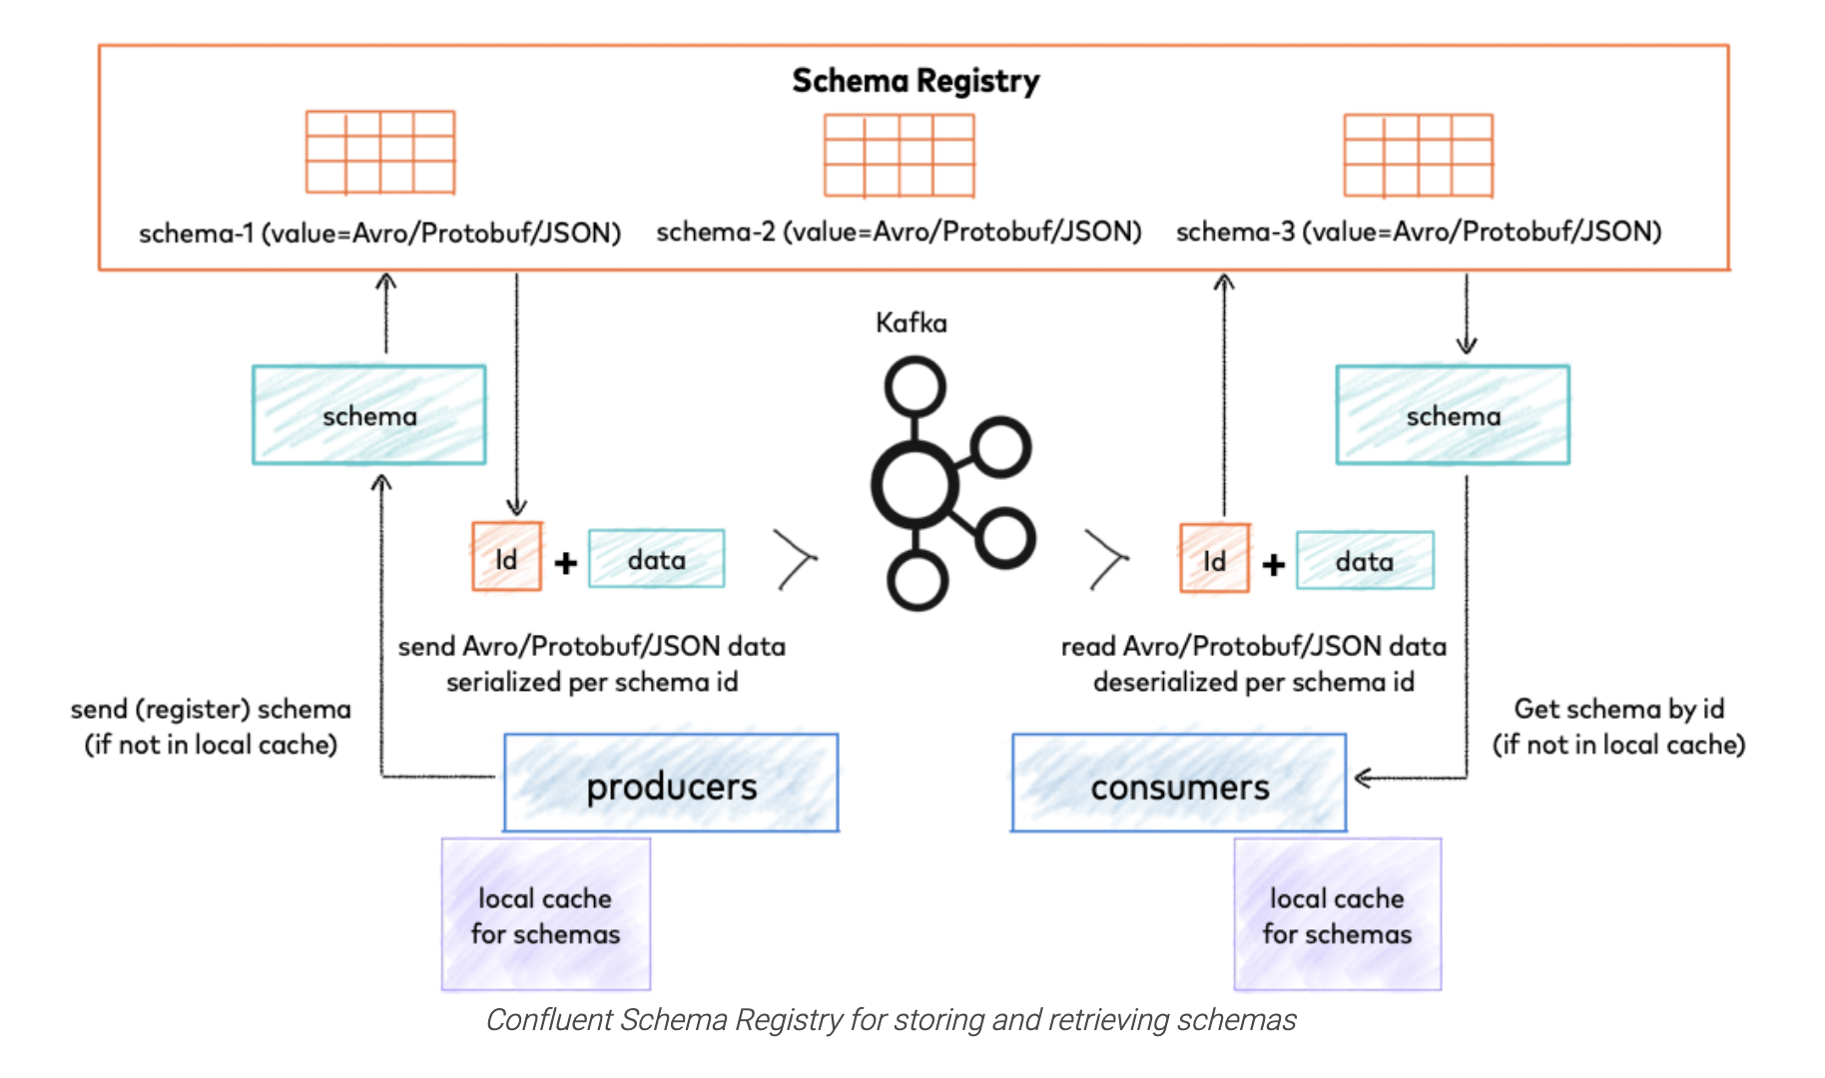
Schema Registry
Endpoints
Discovery
Describing
Contracts
Tools
https://docs.confluent.io/platform/current/schema-registry/index.html

Slide 45
Cloud Events
Endpoints
Discovery
Describing
Contracts
Tools
Id - unique identifier
Unique
source - production context
Required Attributes
specversion - CE version
Event
type - name + version
Metadata
Optional Attributes
Payload
datacontenttype - MIME type
dataschema - URI of payload schema
subject – qualifies source
Data
time – timestamp (Internet)

Slide 46
Protocol Binding
Endpoints
Discovery
Describing
Contracts
Tools
Binding Type
amqp 1-0
avro
Binary
http
Uses the protocol’s native approach to metadata
http-webhooks
CloudEvent
kafka
mqtt
Structured
nats
Adds headers to the payload (envelope)
protobuf
websockets

Slide 47
Protocol Binding
Endpoints
Discovery
Describing
Contracts
Tools
Binary
Structured
------------------ Message -------------------
Topic Name: mytopic
------------------- key ----------------------
Key: mykey
------------------ headers -------------------
content-type: application/cloudevents+json; charset=UTF-8
------------------- value --------------------
{
"specversion" : "1.0",
"type" : "com.example.someevent",
"source" : "/mycontext/subcontext",
"id" : "1234-1234-1234",
"time" : "2018-04-05T03:56:24Z",
"datacontenttype" : "application/json",
"data" : {
... application data encoded in JSON ...
}
}
-----------------------------------------------
------------------ Message -------------------
Topic Name: mytopic
------------------- key ----------------------
Key: mykey
------------------ headers ------------------- ce_specversion: "1.0"
ce_type: "com.example.someevent"
ce_source: "/mycontext/subcontext"
ce_id: "1234-1234-1234"
ce_time: "2018-04-05T03:56:24Z"
content-type: application/avro
------------------- value --------------------
... application data encoded in Avro ...
-----------------------------------------------

Slide 48
Tools
35

Slide 49
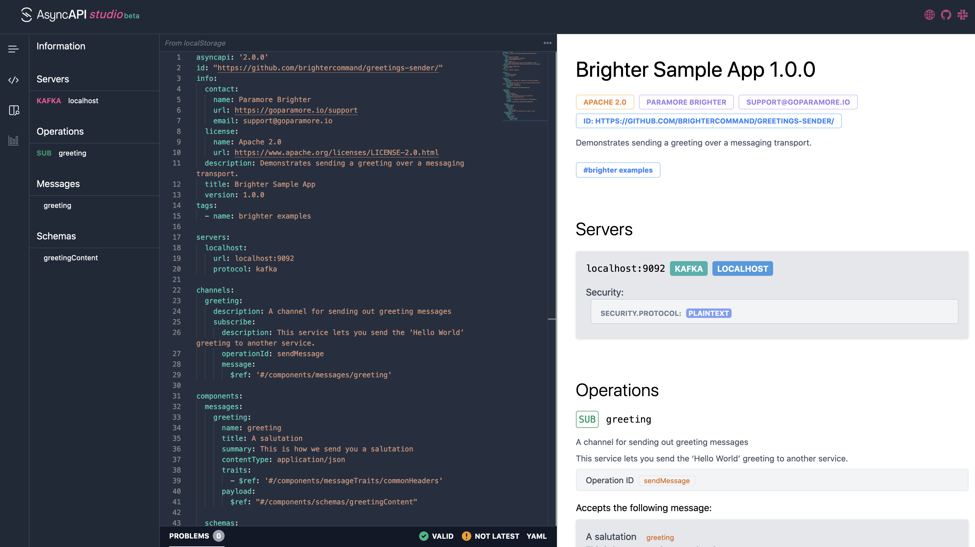
AsyncAPI Studio
Endpoints
Discovery
Describing
Contracts
Tools

Slide 50
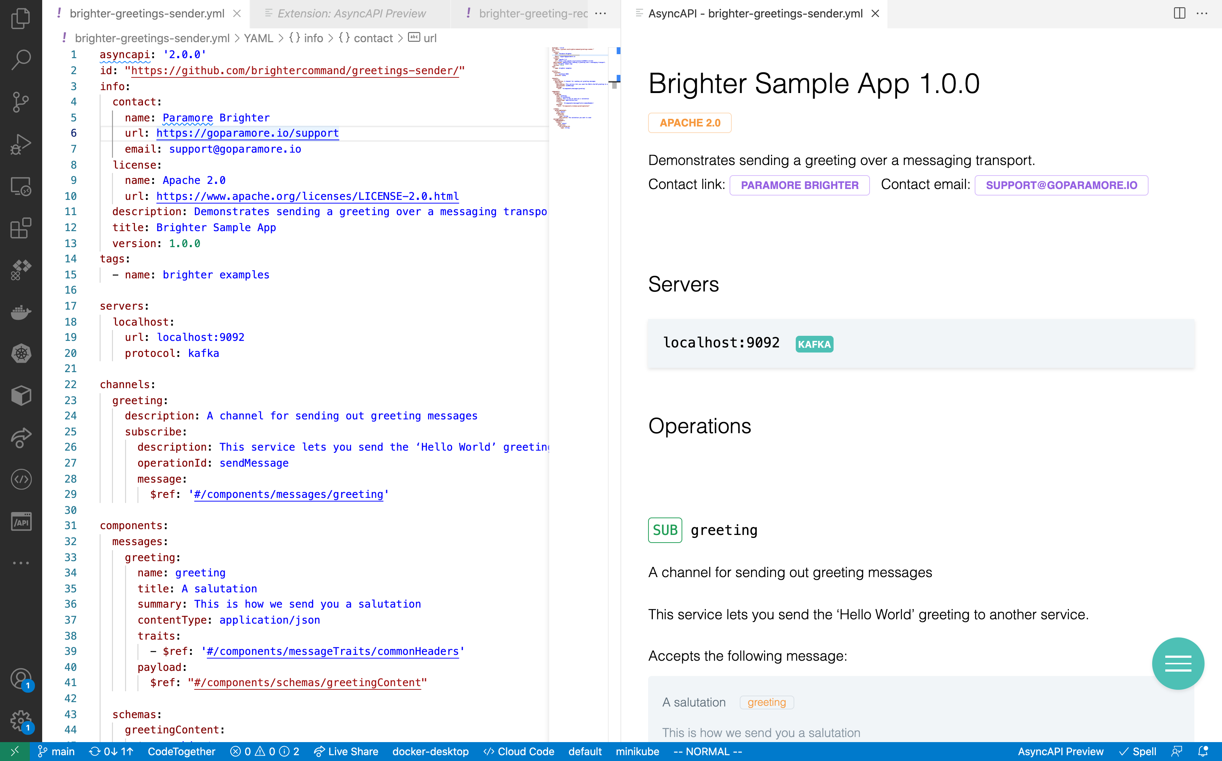
VS Code
Endpoints
Discovery
Describing
Contracts
Tools

Slide 51
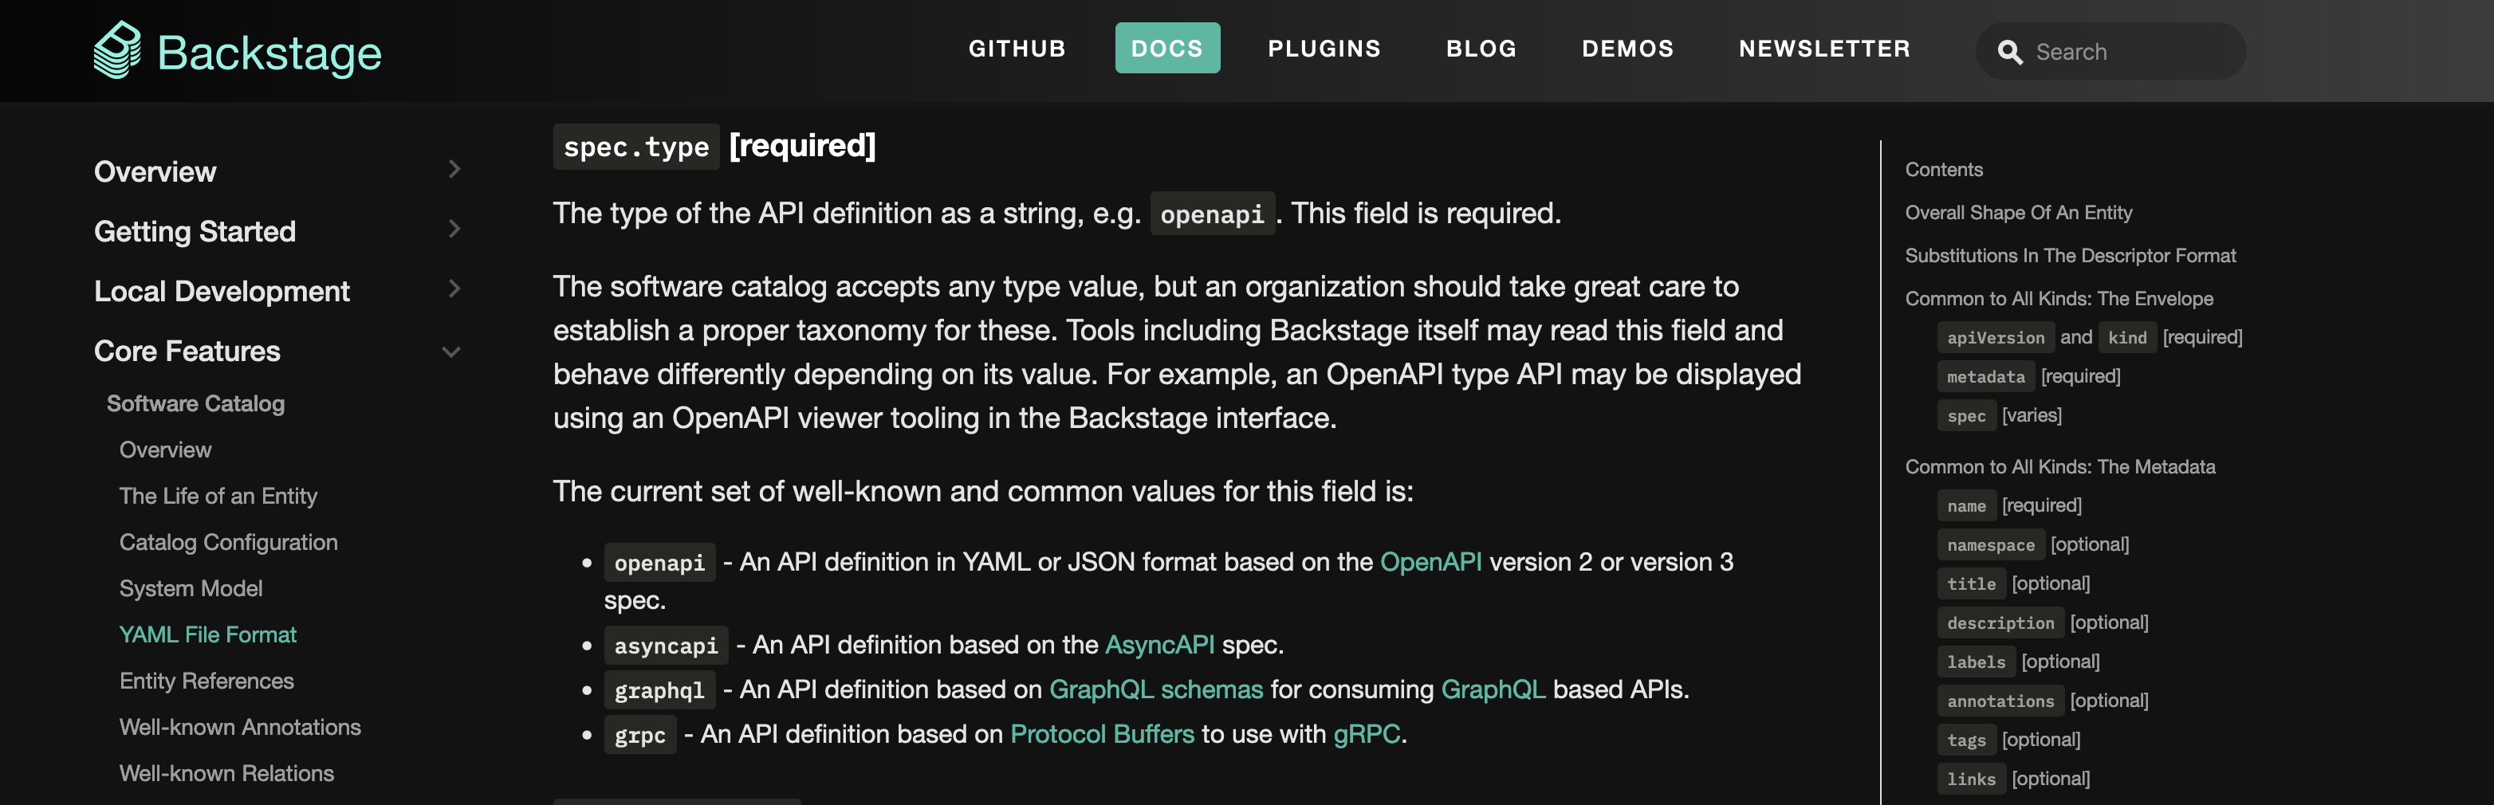
Backstage
Endpoints
Discovery
Describing
Contracts
Tools

Slide 52
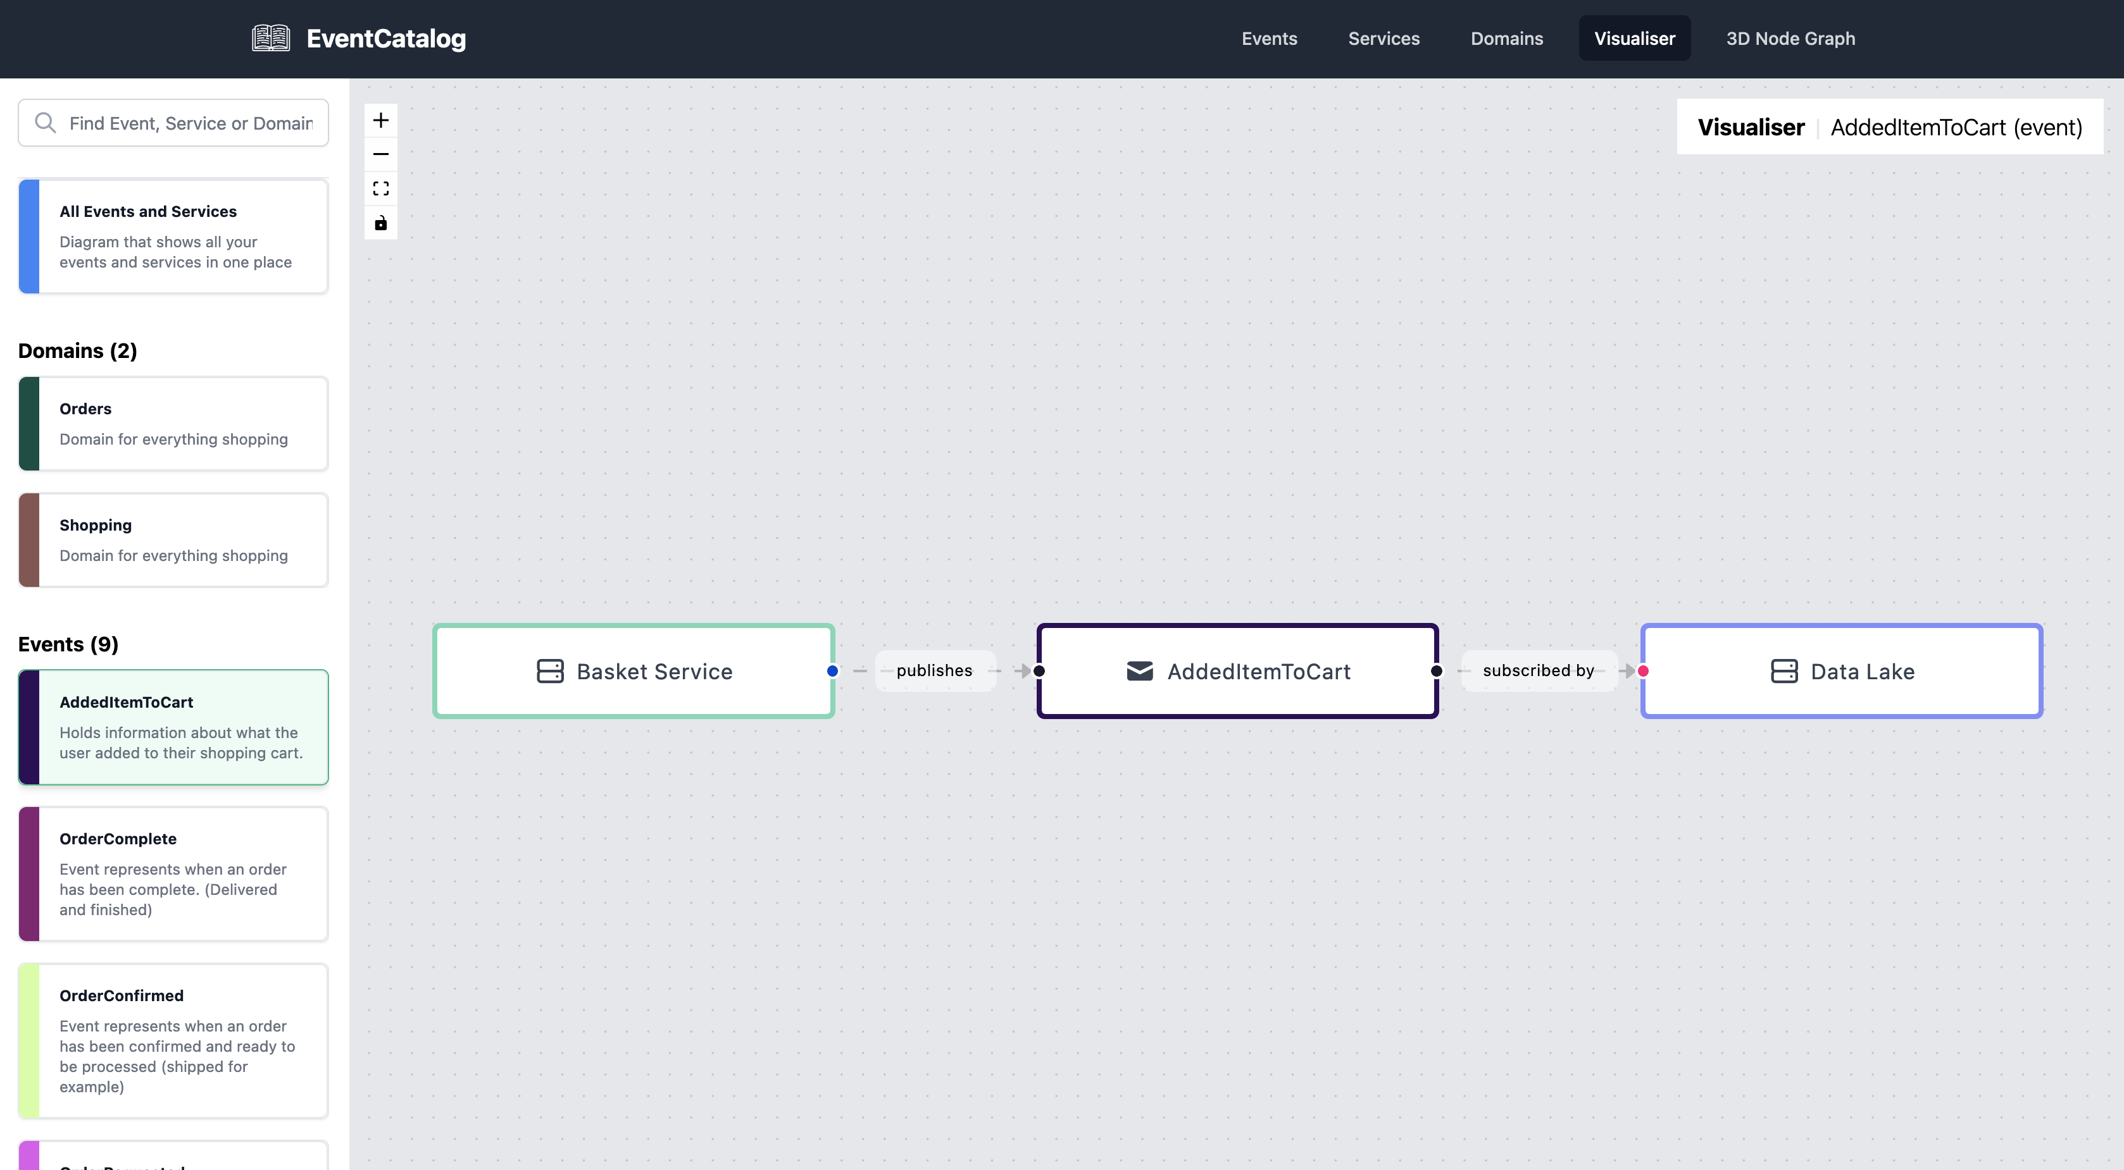
Event Catalog
Endpoints
Discovery
Describing
Contracts
Tools
https://github.com/boyney123/eventcatalog

Slide 53





Generators
Endpoints
Discovery
Describing
Contracts
Tools
Take an ascynapi specification.
Parse it.
Use the parsed specification to provide inputs to a template (React or Nunjucks)
Use the template to spit out new files

Slide 54
Generators
Endpoints
Discovery
Describing
Contracts
Tools
Using the react template approach, you are parsed an object representing the parsed asyncapi file.
import { File, Text} from '@asyncapi/generator-react-sdk';
import { KafkaConfiguration } from '../components/KafkaConfiguration’;
export default function({ asyncapi, params, originalAsyncAPI }) {
const files = [];
const channels = asyncapi.channels();
if(Object.entries(channels).some(([channelName, channel]) => channel.hasPublish() && channel.publish().hasBinding(”kafka"))){
const filename=”kafka.yaml";
files.push(<File name={filename}><KafkaConfiguration channels={channels}/></File>);
}
return files;
}
You spit out the results as one or more files
You write a custom transform to take that parsed specification and create new output from it.

Slide 55


Document Generation
Endpoints
Discovery
Describing
Contracts
Tools
We can generate documentation, such as HTML, to create a catalogue of our services

Slide 56



Generate Infrastructure
Endpoints
Discovery
Describing
Contracts
Tools
The bindings hold information that helps us provision infrastructure. We can extract that, perhaps as JSON
As part of our CI/CD pipeline we can ensure that the infrastructure over which messaging flows exists

Slide 57



Scaffolding
Endpoints
Discovery
Describing
Contracts
Tools

Slide 58
Agenda
Endpoints
Discovery
Describing
Contracts
Tools

Slide 59
End
40

